Slide 1
Chapter Ten
Consumer’s Surplus
消费者剩余

Slide 2
Structure
Reservation price
Consumer’s surplus
Changes in consumer’s surplus

Slide 3
Reservation Price
Maximum willingness to pay for an additional unit of a good.
The price at which the consumer is just indifferent to consuming or not consuming the good.

Slide 4
Reservation Price
Reservation price for the 1st unit (r₁)
u(0, m) = u(1, m-r₁)
r₁ is the reservation price for consuming the 1st unit.
Reservation price for the 2nd unit (r₂)
u(1, m-r₂) = u(2, m-2r₂)
r₂ is the reservation price for consuming the 2nd unit.
Reservation price for the 3rd unit (r₃)
u(2, m-2r₃) = u(3, m-3r₃)

Slide 5
Quasi-Linear Utility
U(x, y) = v(x) + y
Reservation prices for the first 3 units:
v(0)+m=v(1)+m- r₁ ⇒ r₁= v(1) - v(0)
v(1)+m- r₂=v(2)+m- 2r₂ ⇒ r₂= v(2) - v(1)
v(2)+m- 2r₃=v(3)+m- 3r₃ ⇒ r₃= v(3) - v(2)
r₁+r₂+r₃=v(3)-v(0)=v(3)
This is the gross benefit （毛收益）of consuming 3 units of good x.

Slide 6
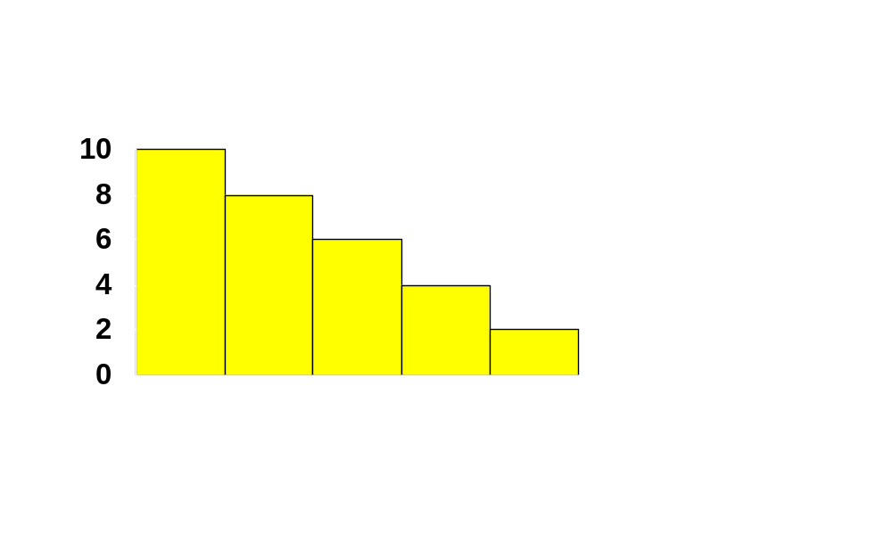
Reservation Prices and Utility Gains
r₁
r₂
r₃
r₄
r₅
r₆
1
2
3
4
5
6

Slide 7
Reservation Prices and Utility Gains
Generally, if she already has n-1 gallons of gasoline then r_{n} denotes the most she will pay for an nth gallon.
  r_{n} is the marginal utility of the nth gallon.

Slide 8
Reservation Prices and Utility Gains
r₁ + … + r_{n} will be the total change to utility from consuming n gallons of gasoline at a price of $0.

Slide 9
Reservation Prices and Utility Gains
What is the utility gains by the consumer in the gasoline market at a price of $p_{G}?

Slide 10
Reservation Prices and Utility Gains
The dollar equivalent net utility gain for the 1st gallon is $(r₁ - p_{G})
and is $(r₂ - p_{G}) for the 2nd gallon,
and so on, so the total net utility gain is
$(r₁ - p_{G}) + $(r₂ - p_{G}) + …
for as long as r_{n} - p_{G} > 0.

Slide 11
Reservation Prices and Utility Gains
So r₁ + … + r_{n} - p_{G}n will be the total change to utility from consuming n gallons of gasoline at a price of $p_{G} each.

Slide 12
Reservation Prices and Utility Gains
r₁
r₂
r₃
r₄
p_{G}
r₅
r₆
1
2
3
4
5
6

Slide 13
Reservation Prices and Utility Gains
r₁
r₂
r₃
r₄
p_{G}
r₅
r₆
1
2
3
4
5
6

Slide 14
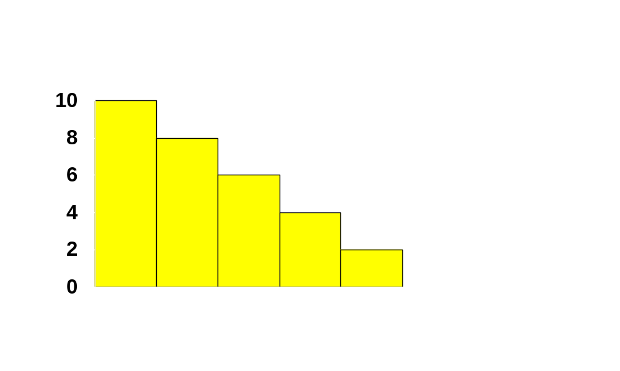
Reservation Prices and Utility Gains
$ value of net utility gains-to-trade
r₁
r₂
r₃
r₄
p_{G}
r₅
r₆
1
2
3
4
5
6

Slide 15
Reservation Prices and Utility Gains
If gasoline can be purchased in any quantity then ...

Slide 16
Reservation Prices and Utility Gains
($) Res.
Prices
Reservation Price Curve for Gasoline
Gasoline

Slide 17
Reservation Prices and Utility Gains
($) Res.
Prices
Reservation Price Curve for Gasoline
p_{G}
Gasoline

Slide 18
Reservation Prices and Utility Gains
($) Res.
Prices
Reservation Price Curve for Gasoline
$ value of net utility gains-to-trade
p_{G}
Gasoline

Slide 19
Reservation Prices and Utility Gains
The downward sloping reservation price curve is in fact the demand curve for the good.
For this to hold, the key assumption is quasilinear utility. In other cases, this does not hold
Unfortunately, estimating a consumer’s reservation-price curve is difficult.

Slide 20
Reservation Prices and Utility Gains
so, as an approximation, we use the consumer’s ordinary demand curve.
This approximation gives the Consumer’s Surplus measure of net utility gain.

Slide 21
Consumer’s Surplus
If the consumer’s utility function is quasilinear in income then
  The reservation price curve is exactly the demand curve
  Consumer’s Surplus is an exact $ measure of gains-to-trade.
If income effects are small, then the approximation is good.

Slide 22



Consumer’s Surplus
p₁
Ordinary demand curve,
is the consumer’s surplus from consuming x₁’ units of commodity 1.
CS

Slide 23
Interpreting Consumer’s Surplus
Net benefit of consuming n units of the good:
Compensation needed to give up consuming the product.

Slide 24
Change in Consumer’s Surplus
p₁
p₁(x₁), the inverse ordinary demand
curve for commodity 1

Slide 25
Consumer’s Surplus
p₁
p₁(x₁)
CS before

Slide 26


Consumer’s Surplus
p₁
p₁(x₁)
CS after

Slide 27
Consumer’s Surplus
p₁
p₁(x₁), inverse ordinary demand
curve for commodity 1.
Lost CS

